Slide 1
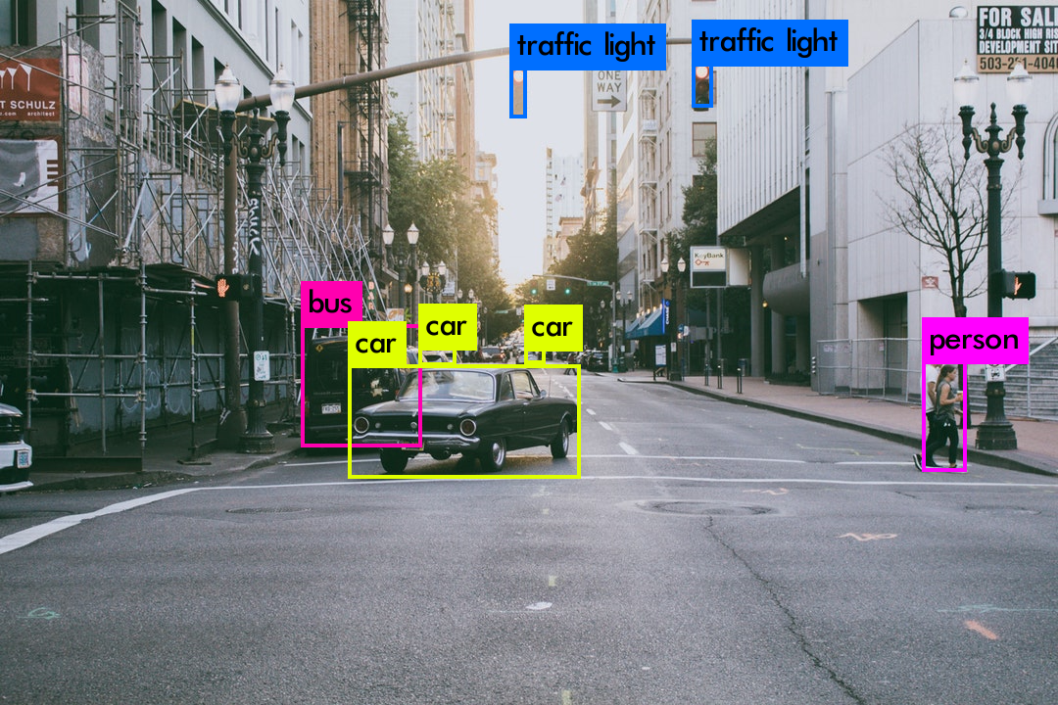
object tracking based on colour
Created by:
SRIMATHI.S
REG.NO.912321104041
3rd year-CSE
SACS M.A.V.M.M Engineering college,madurai.

Slide 2

Outline
Problem statement
Proposed system/solution
System development approach
Algorithm and deployment
Result
Conclusion
2

Slide 3
Problem statement
The objective is to detect and track the generic object in real time. In real life, therefore, we require rich information about the surrounding. We need to understand how the objects are moving with respect to the camera. It would also help to recognize the interaction between objects. Color-based detection refers to the use of color information to detect and identify objects or regions of interest in an image or environment. It involves analyzing the color values of pixels or light reflected from objects to determine their color characteristics.
3

Slide 4
Proposed system/solution
Color Model SelectionChoose a suitable color model(e.g., RGB, HSV)based on the application requirements and characteristics of the objects to be tracked.
Color Segmentation: Segment the input image or video frames into regions of interest based on predefined color thresholds or clustering algorithms.
Object Representation: Represent each segmented region as a object candidate, storing its color properties (e.g., mean color, color histogram).
4

Slide 5
Proposed system/solution (contd..)
Initial Object Localization:intialize object trackers for each detected object candidate to estimate their initial positions.
Frame-by-Frame Tracking: For each subsequent frame, update the position of each tracked object based on its color appearance in the current
Adaptive Color Model Updating: Dynamically adapt the color model parameters or thresholds to andle the variations in lighting conditions, object appearances, and occlusions.
16

Slide 6
Proposed system/solution (contd... )
Feedback Loop:
Implement a feedback loop to refine the tracking results based on user input or additional sensor data.
Performance Optimization:
Optimize the algorithm for real-time performance by leveraging parallel processing, GPU acceleration, and efficient data structures
.
Robustness Enhancements:
Enhance robustness against noise, occlusions, and cluttered backgrounds bncorporating techniques like background subtraction, adaptive thresholding, and outlier rejection.
5

Slide 7
Software Development approach
Requirement Analysis: Understand the specific requirements of the object tracking system, including the types of objects to the be tracked, environmental conditions, performance expectations, and integration with other systems or platforms.
Algorithm Selection: Choose appropriate colorbased tracking algorithms based on the requirements and constraints of the project.
6

Slide 8
Software Development approach (contd.. )
Prototype Development: Start by building aprototype or proof-of-concept implementation to validate the chosen algorithms and demonstrate basic functionalit
Integration with Image Processing Libraries: Integrate the chosen algorithms with image processing libraries or framework like OpenCV, MATLAB, or scikit-image to leverage existing implementations and optimize performance.
User Interface Design:Design a ser-friendly interface for configuring the tracking system parameters, visualizing the nput video stream or image, and displaying the tracked objects and their trajectories.
17

Slide 9
Software Development Approach (contd...)
User Interface Design:Design user-friendly i nterface for configuring tracking system parameters, visualizing the input video stream or image, and displaying the tracked objects
Implementation: Develop the software components for color segmentation ,object detection, and tracking based on the selected algorithms.
Testing and Validation: Conduct comprehensive esting evaluate the accuracy, robustness, and efficiency ofthe tracking system across different test scenarios and datasets.
7

Slide 10
Software Development Approach (contd..)
Iterative Refinement: I terate on the design and implementation based on testing results, user feedback, and performance benchmarks.
Documentation and Deployment: Document the software architecture, algorithms, and usage instructions comprehensively.
Maintenance and Support: Provide ongoing maintenance andsupport to address any issues, updates, or enhancementsrequired post-deployment.
18

Slide 11
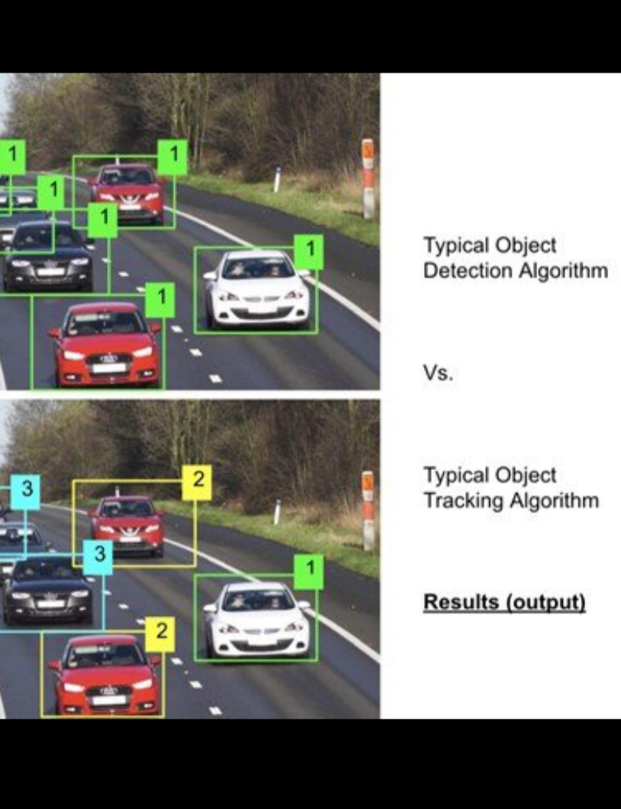
Algorithm and Development
Initialize: Define the target color range or create a color histogram representing the object you want to track.
Capture Frame: Capture a frame from the input video stream or load an image.
Color Segmentation: Convert the frame to the chosen color space.
Blob Detection: Use blob detection techniques to identify connected region of pixels corresponding to potential objects..
8

Slide 12
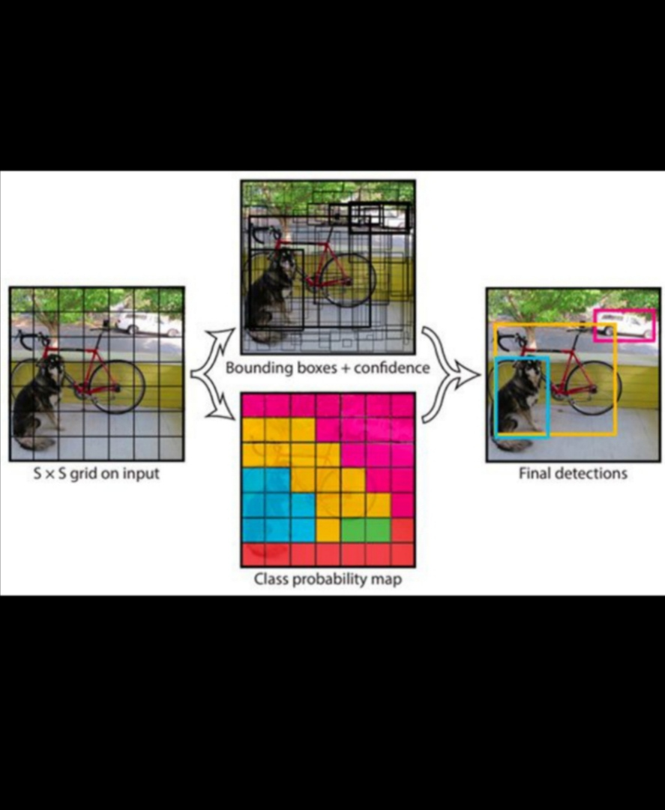
Algorithm and Development (contd...)
Object Tracking: I f it's the first rame, initialize the tracker by selecting the object region.
Visualize Results:Draw a bounding box or contour around the tracked object region on the frame.
Repeat: Repeat steps 2 to 6 or eachframe in the video stream or image sequence.
9

Slide 13
Algorithm and Development (contd..)
Deploying an object tracking system based on color involves several steps to ensure it functions effectively in the intended environment. Here's a deployment plan
Deployment:
Platform selection
Software packaging
User interface development
Integration with existing system
Testing
Deployment
Monitoring and maintenance
10

Slide 14
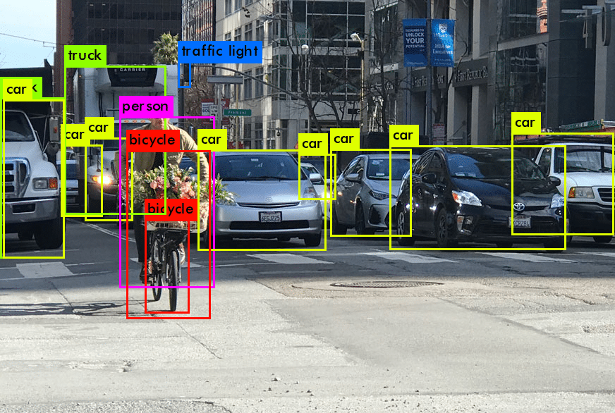
Result
Fig:Object tracking in computer vision
11

Slide 15
Result (contd)
Fig: Object tracking with deep sort and yolo
12

Slide 16
Conclusion
Based on the results of object tracking based on color, it can be concluded that the algorithm successfully identifies and follows the object of interest in the video or image sequence. However, the accuracy and reliability of the tracking may. vary depending on factors such as lighting conditions , background complexity, and this
the distinctiveness of the object's color. Further refinement and optimization of the algorithm may be necessary to improve tracking performance in various scenarios.
14

Slide 17
Reference
https://nevonprojects.com/object-tracker-based-on-color
https//www.researchgate.net/publication/333417_Object_Tracking_Significance_of_Color_Features_A_Review
https://www.augmentedstartups.com/blog/top-5-object-tracking-methods-enhancing-precision-and-efficiency
https://manivannan-ai.medium.com/multiple-object-tracking-algorithms-a01973272e52
https://www.kaggle.com/datasets/adityabhndari/color-detection-data-set
13

Slide 18

15

Slide 19
19

Slide 20
20

Slide 21
21

Slide 22
22

Slide 23
23

Slide 24
24

Slide 25
25

